Slide 1
XAML for Windows 10: Layouts
Daren May | President, CRANK211
Jerry Nixon | Developer Evangelist, Microsoft

Slide 2

Meet Daren May | ‏@darenmay
Daren May is the President and co-founder of Crank211 — a company that specializes in designing and building next-level digital experiences.
Daren has written and presented a number of MVAs and spoken at Microsoft Ignite. He has been developing XAML-based solutions since the heady days of “Avalon” (the early name for WPF).

Slide 3


Meet Jerry Nixon | ‏@jerrynixon
Microsoft Developer Evangelist
Reaching Professional & Student Communities
Teaching Developers about Windows
Teaching Developers about XAML
Author of Template 10
http://jerrynixon.com

Slide 4
Course Topics
XAML for Windows 10: Layouts
01 | Layout Fundamentals | 03 | Custom Panels
02 | Custom Panel

Slide 5
Setting Expectations
Target Audience
Developers looking to make apps for Windows 10
Suggested Prerequisites/Supporting Material
Basic C# knowledge
Basic XAML

Slide 6
Recommended Resources
https://dev.windows.com/
MSDN Windows 10 XAML Overview
https://msdn.microsoft.com/en-us/library/windows/apps/mt185595.aspx

Slide 7
01 | Layout Fundamentals

Slide 8
Module Overview
XAML Summary
Layout Controls

Slide 9
XAML Summary

Slide 10
What is XAML?
XAML – eXtensible Application Markup Language
Object instantiation and property setting
Define UI in declarative fashion

Slide 11
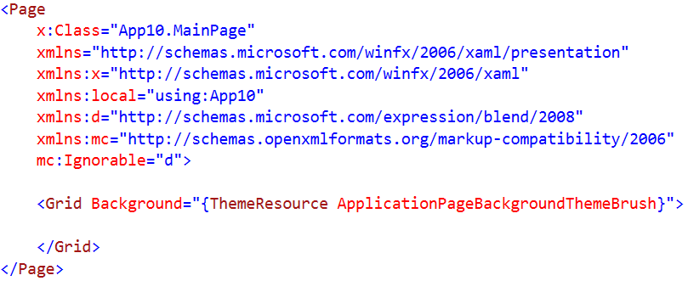
XAML Namespaces
1
2
3
4
5
Maps the overall XAML client / framework as the default namespace
Maps common programming constructs and data intrinsics to the x: namespace – x:Name, x:Boolean, etc.
Maps the current app C# namespace to local:
Maps the Blend namespace to d:
Maps the Markup Compatibility to mc:
Allows the use of mc:ignorable to prevent the XAML processor raising errors on namespaces

Slide 12
Common x: constructs
Term | Description
x:Key | Unique key for an entry in a resource dictionary
x:Class | Specifies the code namespace and class name fro the code-behind for a XAML page
x:Name | Specifies the instance name for the object created when a XAML element is processed at run-time. Essentially creates a backing variable with the name.
x:Uid | Identifies elements that use localized resources
x:Bind | New for Windows 10 and is an alternative to {Binding}
XAML Intrinsic Types | The types that can be used for simple value-types in resources – i.e. x:Boolean x:String x:Null

Slide 13
Markup Extensions
Term | Description
{Binding} | Supports data binding
{StaticResource} | References resources defined in a Resource Dictionary
{ThemeResource} | Similar to {StaticResource} but can respond to run-time theme changes
{TemplateBinding} | A special type of {Binding} that supports control templates
{RelativeSource} | Allows template bindings to reference values from the templated parent
{CustomResource} | Enables advanced resource lookup scenarios

Slide 14



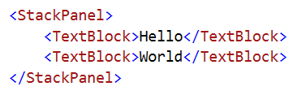
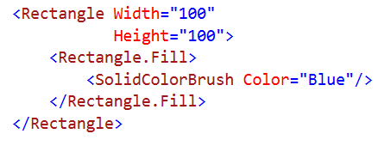
XAML Syntax
Elements
Containers
Properties
Attached Properties
Collection Syntax

Slide 15

XAML Demo

Slide 16
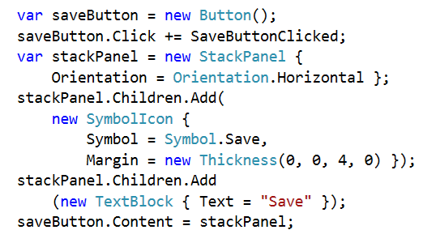
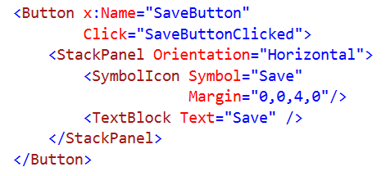
XAML vs Code
XAML
Code

Slide 17
Layout Controls

Slide 18
Why do we need layout controls?
Manual positioning / Fixed layout are not responsive
Layout is a result of interaction between parent and child elements:
Parent to Child: “How much space do you want?”
Child to Parent: “I would like (width, height) based on my content”
Parent considers constraints and other children…
Parent to Child: “You have (width1, height1) at location (x,y)”
Different layout controls apply different constraints

Slide 19
Child Layout Properties
Input
Height & Width – try to avoid setting explicitly
MinHeight & MinWidth
MaxHeight & MaxWidth
Output
DesiredSize – calculated during layout
RenderSize* – size after layout is complete
ActualHeight & ActualWidth* – height and width from RenderSize
Note: Elements try to render as small as possible
* Only safe to rely on in LayoutUpdated

Slide 20
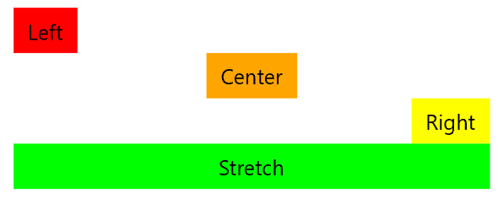
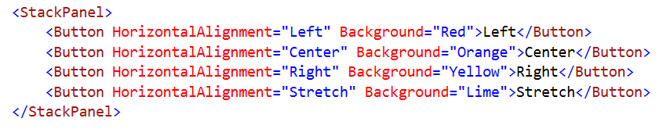
Child Layout Properties
HorizontalAlignment
Left, Center, Right and Stretch
VerticalAlignment
Top, Center, Bottom and Stretch
Configures element alignment within their parent

Slide 21
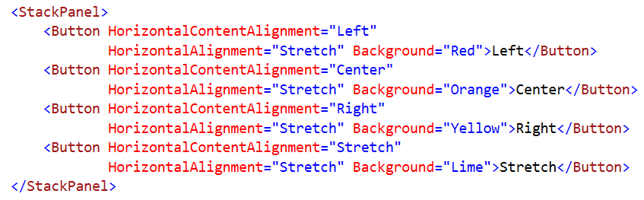
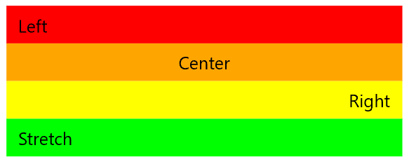
Child Layout Properties
HorizontalContentAlignment
Left, Center, Right and Stretch
VerticalContentAlignment
Top, Center, Bottom and Stretch
Configures content alignment within the element

Slide 22
Child Layout Properties
Margin
All FrameworkElements
Controls space around the *outside* of the element
Padding
All Controls
Controls space around the *inside* of the element
Visibility – Visible & Collapsed
Collapsed elements have no size
Collapsed elements are still instantiated

Slide 23
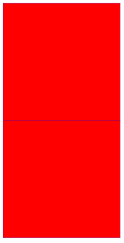
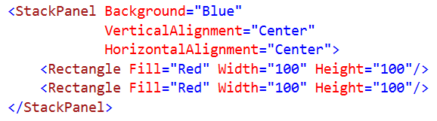
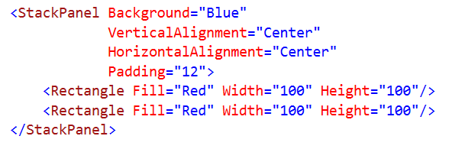
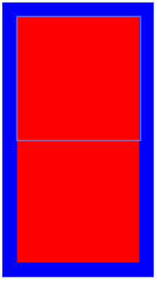
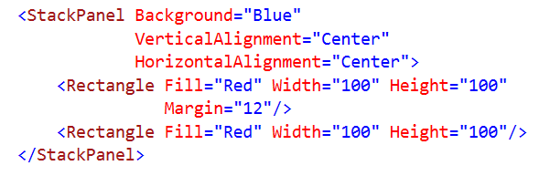
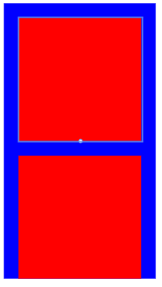
Child Layout Properties
No Parent Padding
Parent Padding
First Rectangle Margin

Slide 24
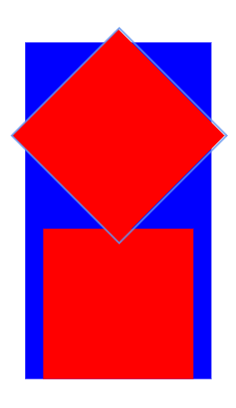
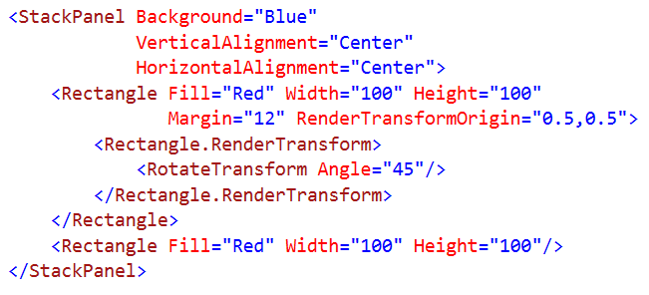
RenderTransforms
Note that render transformations occur after layout, so they do not impact their container sizing:

Slide 25

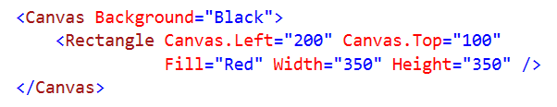
Layout Controls - Canvas
Layout children using fixed positioning via attached properties:
Canvas.Left & Canvas.Top

Slide 26

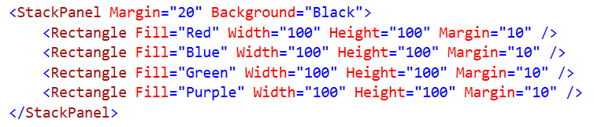
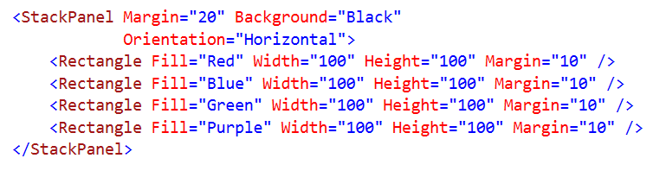

Layout Controls - StackPanel
Arranges children in a simple line – either vertically or horizontally

Slide 27
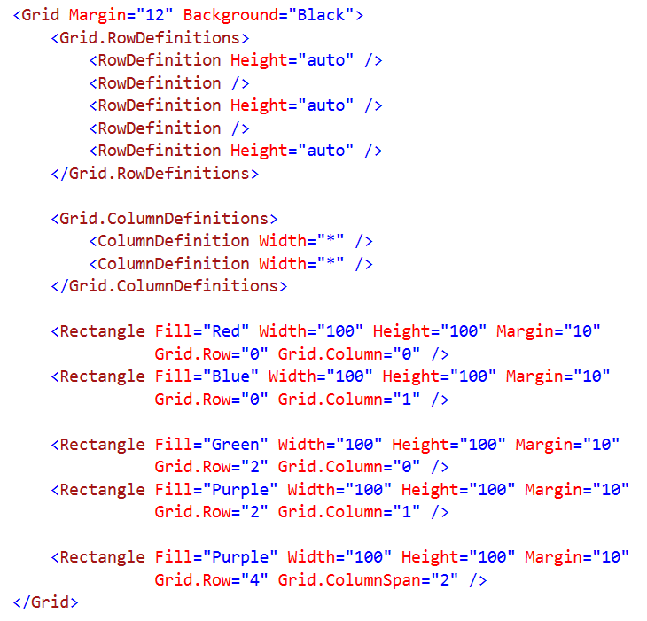

Layout Controls - Grid
Arranges children in a multi-row and multi-column layout
Grid.Row, Grid.Column, Grid.RowSpan, Grid.ColumnSpan

Slide 28
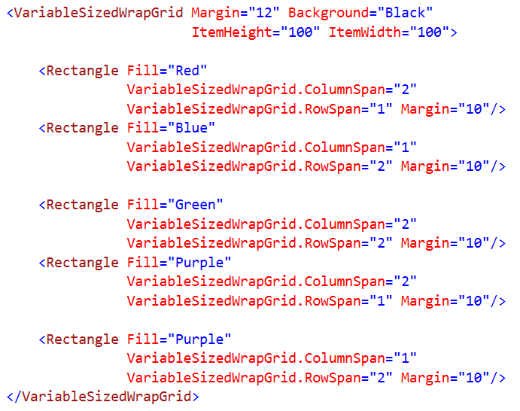
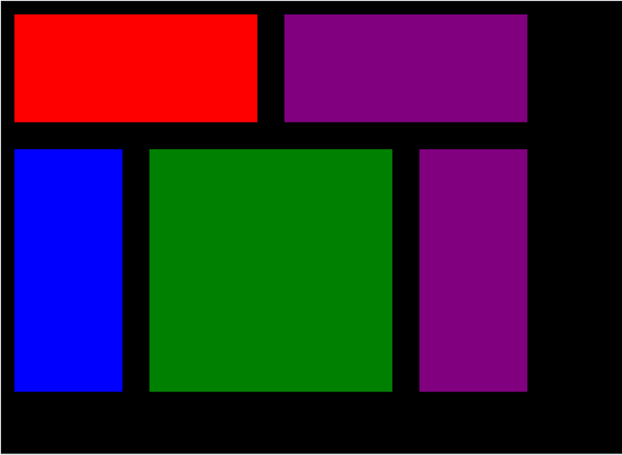
Layout Controls - VariableSizedWrapGrid
Arranges elements in rows or columns that wrap as needed or when the MaximumRowsOrColumns is reached.

Slide 29
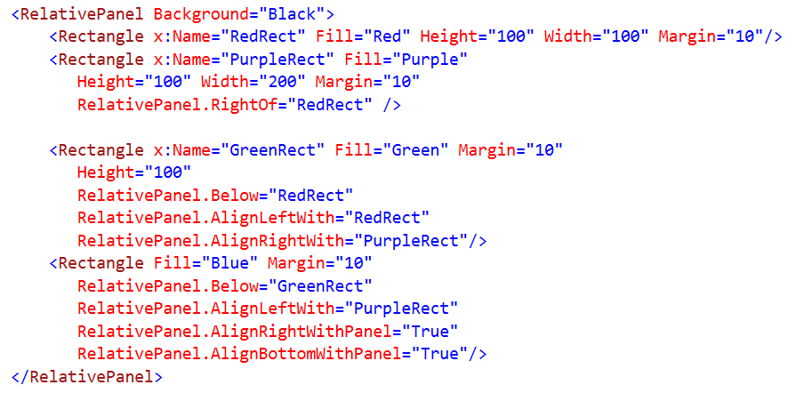
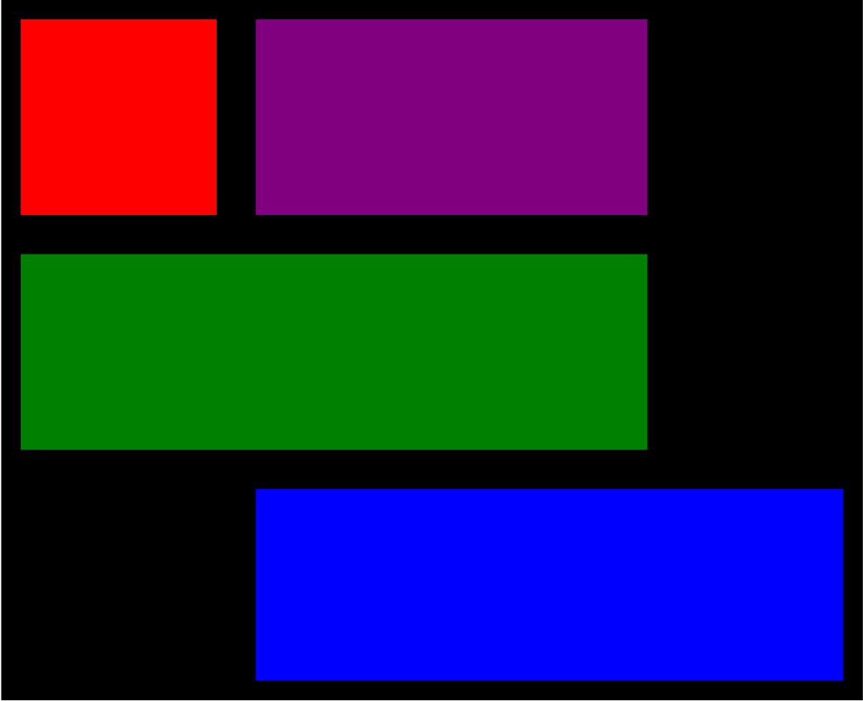
Layout Controls - RelativePanel
Arranges children relative to the panel and/or other elements

Slide 30
Layout Demos

Slide 31
Summary
XAML Summary
Layout Controls

